Slide 1


That’s Jazz!
Exploring Pulse and Rhythm
Unit 29

Slide 2





For all of our plans in this unit, we have three areas of teaching: a focus activity, the main content and a plenary. These areas can be identified by a different border colour to the background.
Plan & Unit Guidance
Focus Activity
Main Content
Plenary
Different icons for audio and video will appear that allow you to interact with the content. Icons will work by hovering over them and then clicking the play button that appears underneath.
Play Audio Track
Play Video

Slide 3


Lesson 5

Slide 4
Learning Objective(s):
All children will perform a three-part cyclic rhythm, through clapping with untuned percussion instruments.
Listening Focus:
Comparing Feeling Good by Nina Simone with a Version by MUSE

Slide 5
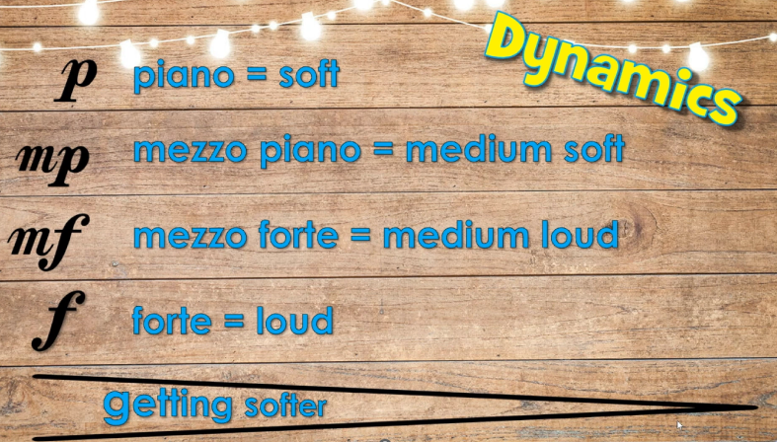

Glenn Miller - ‘In the Mood’
Play Along Key
Crotchet rest
1 beat rest (silence)
Click to reveal
Crotchet
1 beat
Two quavers
Each one lasts ½ a beat
Click to reveal
Click to reveal

Slide 6



‘In the Mood’ Play Along

Slide 7


New Orleans Jazz
New Orleans Virtual School Trip
Jump to Listening

Slide 8

New Orleans Virtual School Trip

Slide 9
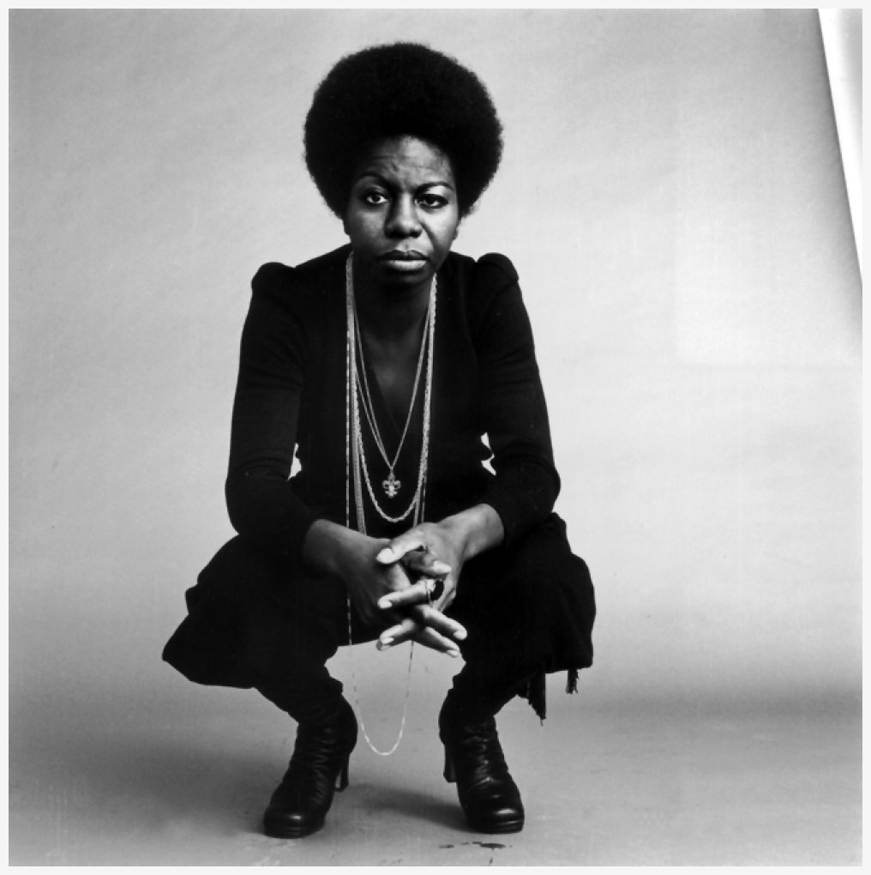
‘Feeling Good’ by Nina Simone
Nina Simone was an American singer who took the New Orleans style of jazz and mixed it with classical piano music.
She was a classically educated pianist who went to the prestigious Juilliard music school.
She was very active in the civil rights movement, fighting for equal rights for black Americans.
Simone was an incredibly well-respected jazz musician and was known as the High Priestess of Soul.
She was active from 1954-2002 and released ‘Feeling Good’ in 1965.

Slide 10
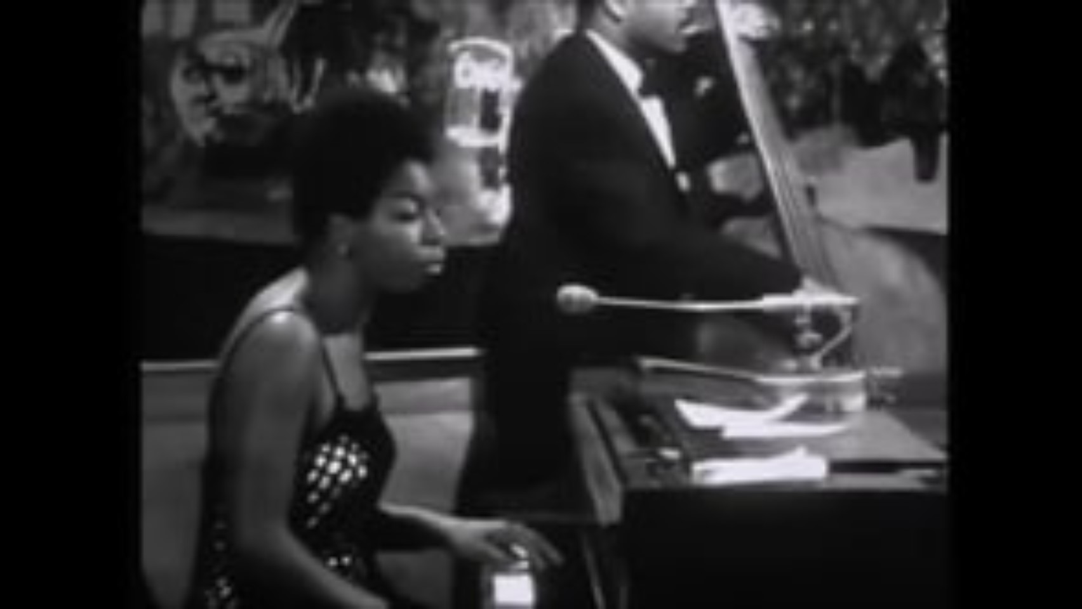
Feeling Good by Nina Simone

Slide 11

‘Feeling Good’ by MUSE
MUSE are a multi-award-winning rock/heavy metal band from Devon, England.
They are well known as a fantastic and energetic live band, famous for their loud festival performances.
They have been active from 1994 to the present day.
This version of ‘Feeling Good’ was released in 2001.

Slide 12

Feeling Good by MUSE

Slide 13
Feeling Good
vs
‘Feeling Good’ by Nina Simone
‘Feeling Good’ by MUSE
What are the differences between these two versions?
Think about instrumentation, style, whether or not the lead singer scats, etc.

Slide 14
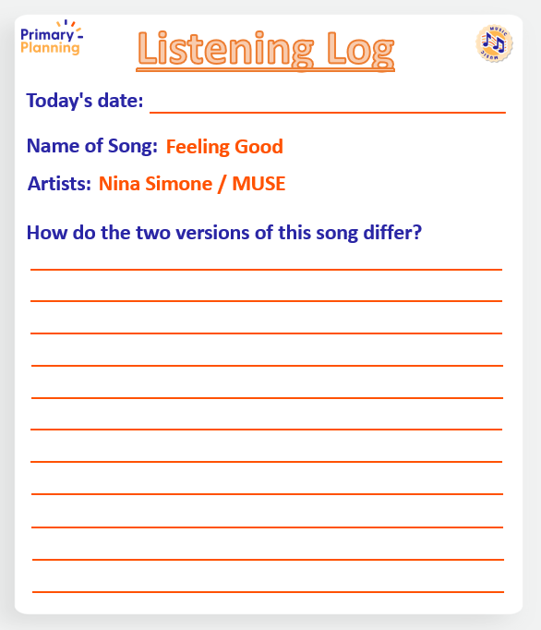
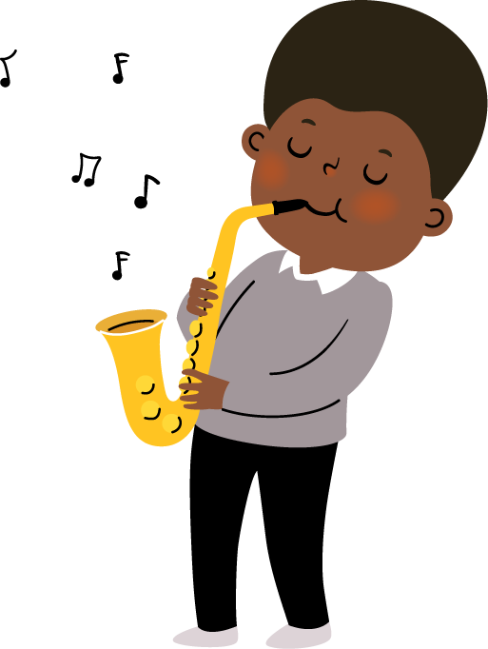
Listening Log

Slide 15

Great Big House in New Orleans

Slide 16

Great Big House in New Orleans
Great big house in New Orleans
Forty storeys high
Every room that I’ve been in
Filled with pumpkin pie
Went down to the old mill stream
To fetch a pail of water
Put one arm around my wife
The other ‘round my daughter
Fare thee well my darling girl
Fare thee well my daughter
Fare thee well my darling girl
Golden slippers on her.

Slide 17
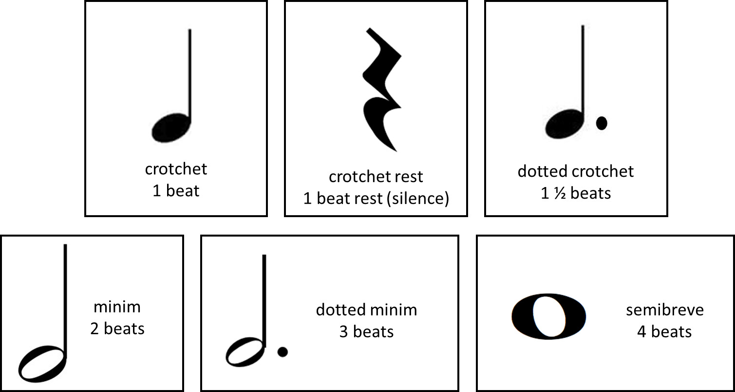



Musical Notation
Crotchet
1 beat
Crotchet rest
1 beat rest (silence)
Dotted crotchet
1 ½ beats
Click to reveal
Click to reveal
Click to reveal
Minim
2 beats
Dotted minim
3 beats
Semibreve
4 beats
Click to reveal
Click to reveal
Click to reveal

Slide 18
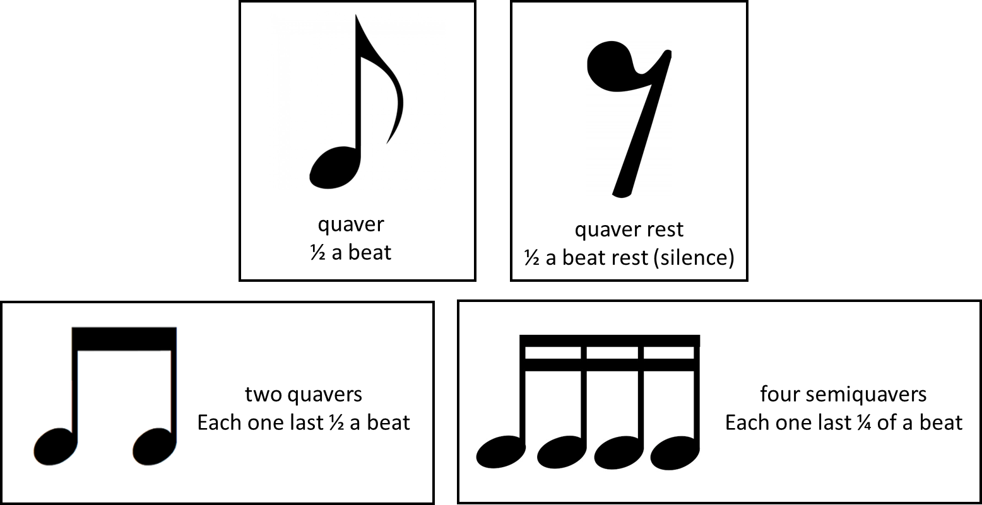
Musical Notation
Quaver
½ a beat
Click to reveal
Quaver rest
½ a beat rest (silence)
Click to reveal
Two quavers
Each one lasts ½ a beat
Four semiquavers
Each one lasts ¼ a beat
Click to reveal
Click to reveal

Slide 19
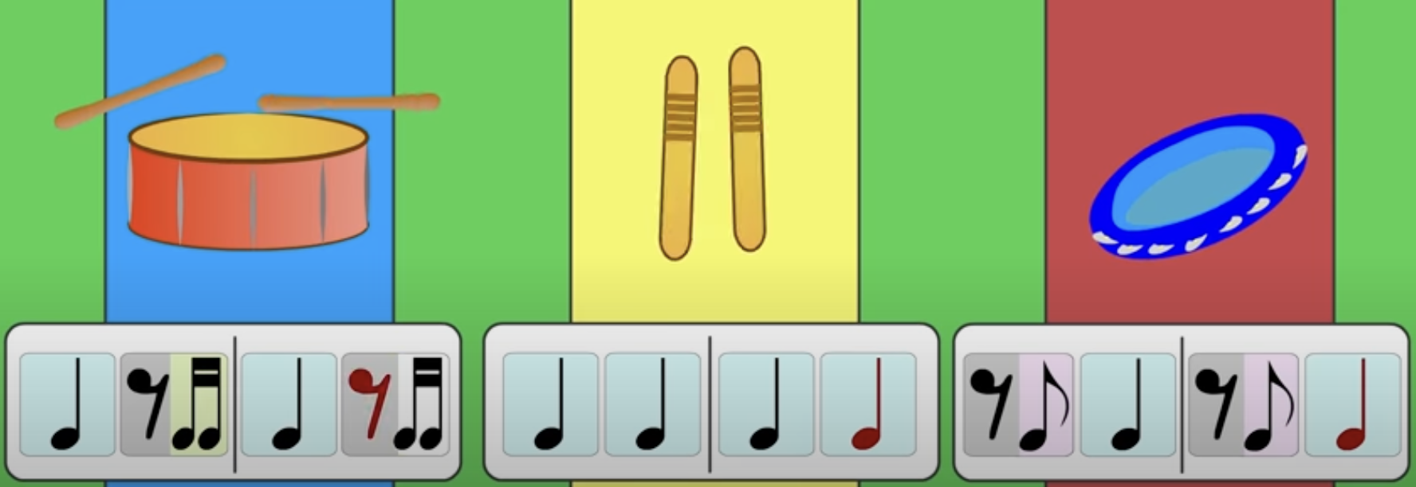
The Three Rhythms for ‘Great Big House in New Orleans’

Slide 20

Great Big House In New Orleans

